Slide 1
Course Title - Web System Engineering
Topic Title - BUILD INTERFCAES USING BOOTSTARP
Introduction to web design from an evolutionary perspective, user interface design through bootstrap, containers,
tables, jumbotrons, list, cards, carousal, navigation, modals, flex and forms, responsive web page design, basic UI
grid structure.
Presenter’s Name - M ArunKumar
Presenter’s ID - IARE11151
Department Name - CSE ( Artificial Intelligence, and Machine Learning )
Lecture Number - #
Presentation Date - 25/02/2025

Slide 2
carousal, navigation, modals, flex and forms, responsive web page design,basic UI grid structure.
The Grid Layout Module offers a grid-based layout system, with rows and columns.
The Grid Layout Module allows developers to easily create complex web layouts.
The Grid Layout Module makes it easier to design a responsive layout structure, without using float or positioning.

Slide 3
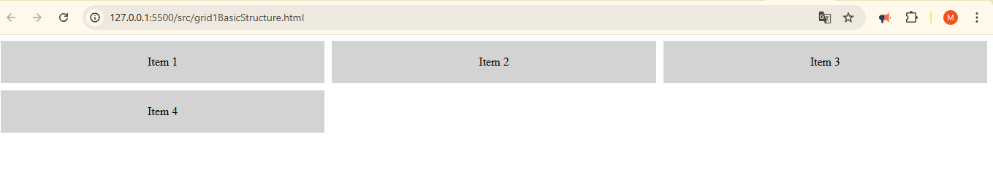
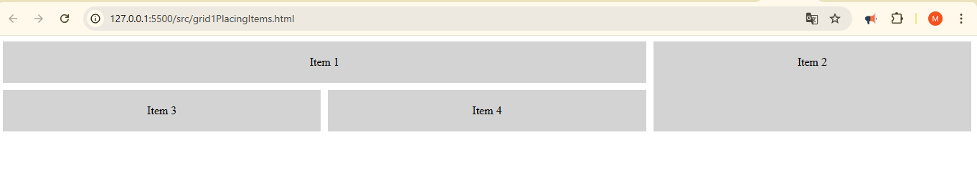
HTML: Grid Basic Layout

Slide 4
Fractional Units (fr)
You can use the fr unit to distribute available space.
grid-template-columns: 1fr 2fr;
This means that the second column will take twice the space of the first one.
Placing Items
You can place grid items explicitly by using grid-column and grid-row.
grid-column: span 2; /* Item 1 takes 2 columns */
grid-row: span 2; /* Item 2 takes 2 rows */

Slide 5
Responsive Design
CSS Grid is ideal for responsive design. You can change the number of columns or the layout based on the screen size using media queries.
.grid-container {
display: grid;
grid-template-columns: repeat(3, 1fr);
gap: 10px; }
@media (max-width: 768px) {
.grid-container {
grid-template-columns: 1fr;
/* Single column on smaller screens */ }
}
Other Useful Properties
align-items – Aligns grid items along the block (vertical) axis.
justify-items – Aligns grid items along the inline (horizontal) axis.
grid-template-areas – Assigns specific names to grid areas for more complex layouts.

Slide 6
Grid : HTML & CSS properties

Slide 7
flex and forms
Flexbox and forms work together seamlessly to create flexible, responsive layouts for form elements.
Flexbox, or CSS Flexible Box Layout, is a layout model that arranges items in a single dimension, such as a row or column.
Key Flexbox Properties:
display: flex – Defines a flex container.
flex-direction – Controls the direction of the items (row, column, row-reverse, column-reverse).
justify-content – Aligns items along the main axis (horizontal by default).
align-items – Aligns items along the cross axis (vertical by default).
flex-wrap – Controls whether items should wrap onto new lines.
flex – A shorthand to control how items grow, shrink, or occupy space.
1. Flexbox Basics
2. Basic Form Layout Using Flexbox
3. Form Layout with Flexbox in Row

Slide 8
Key Flexbox Properties:
display: flex – Defines a flex container.
flex-direction – Controls the direction of the items (row, column, row-reverse, column-reverse).
justify-content – Aligns items along the main axis (horizontal by default).
align-items – Aligns items along the cross axis (vertical by default).
flex-wrap – Controls whether items should wrap onto new lines.
flex – A shorthand to control how items grow, shrink, or occupy space.

Slide 9
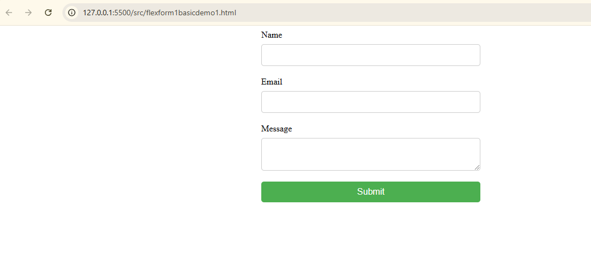
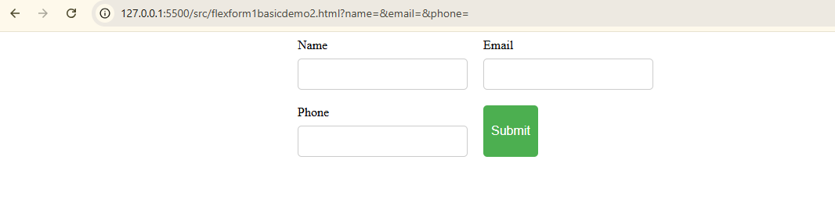
2. Basic Form Layout Using Flexbox
The form is set to a flex container with display: flex; flex-direction: column; so all child items (input fields, labels, and button) stack vertically.
gap: 20px; creates space between form elements.
Each form input field (within .form-item) has its own label that stacks above it, using flex-direction: column inside each .form-item.

Slide 10
Felx & Form : HTML & CSS properties

Slide 11
Concepts for Responsive Web Design
Creating a responsive web page design means designing a web page that adjusts its layout and content dynamically to provide the best viewing experience across a wide range of devices (from desktop computers to mobile phones). This is typically achieved through a combination of flexible grid layouts, CSS media queries, and responsive images.
Key Concepts for Responsive Web Design:
Fluid Grid Layout: Instead of fixed widths (in pixels), use relative units such as percentages, vw (viewport width), vh (viewport height), and em for dimensions.
Media Queries: These allow different styles to be applied based on the device's screen size, orientation, or resolution.
Flexible Images: Use CSS properties like max-width: 100% to ensure images resize properly within their containers.
Viewport Meta Tag: This tells the browser how to scale the page on mobile devices.

Slide 12
Thank You

